Slide 1
Artificial Intelligence
Chapter 8: First Order Logic
Part - 1
- Unfortunately, propositional logic is too puny a language to represent knowledge
of complex environments in a concise way. In this chapter, we examine first-order logic (FOL).
- In FOL, we will notice that the world is blessed with many objects, some of which are related to other objects, and in which we endeavor to reason about them..
Instructor: Zakariya Ahmed Oraibi
University of Basrah, Iraq

Slide 2
FOL Contains
Objects: people, houses, numbers, colors, wars, ….
Predicates: to describe relations between objects.
Example: Red(Car), IsBiggerThan(4,2)
Functions: Father of, best friend, one more than, …..
Example: Sqrt(4), Mul(x, y)

Slide 3
Syntax of FOL
Objects: people, houses, numbers, colors, wars, ….
Predicates: to describe relations between objects.
Example: Red(Car), IsBiggerThan(4,2)
Functions: Father of, best friend, one more than, …..
Example: Sqrt(4), Mul(x, y)

Slide 4
Syntax of FOL

Slide 5
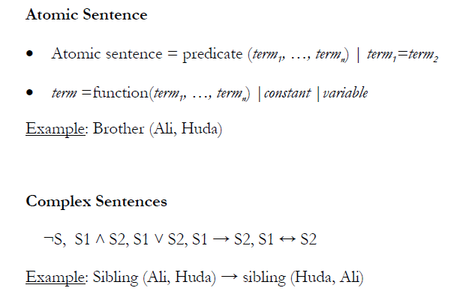
Atomic and Complex Sentences

Slide 6
Universal Quantification
Refers to Universal Quantification

Slide 7
Existential Quantification
Refers to Existential

Slide 8
Inference with FOL
- We will use three methods for FOL inference:
1- Forward Chaining.
2- Backward Chaining.
3- Resolution.
All methods require a technique called Substitution:
Substitution is the replacement of variable(s) in a sentence with expressions
SUBST({x/Richard, y/John}, Brother(x,y))=Brother(Richard, John)

Slide 9
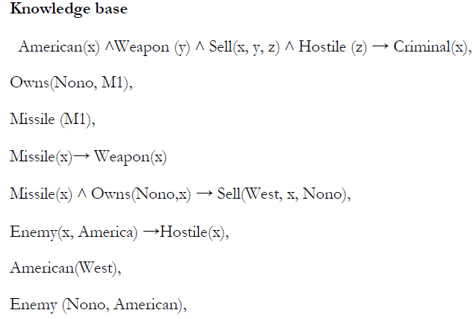
Forward Chaining
Prove: Criminal (West)?
We should start with facts until we reach to the conclusion

Slide 10
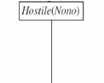
Forward Chaining
Prove: Criminal (West)?

Slide 11
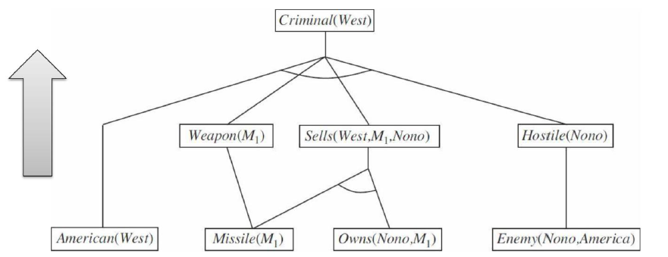
Forward Chaining
x = West
Prove: Criminal (West)?

Slide 12
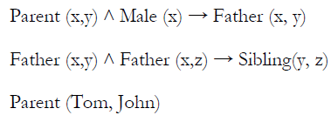
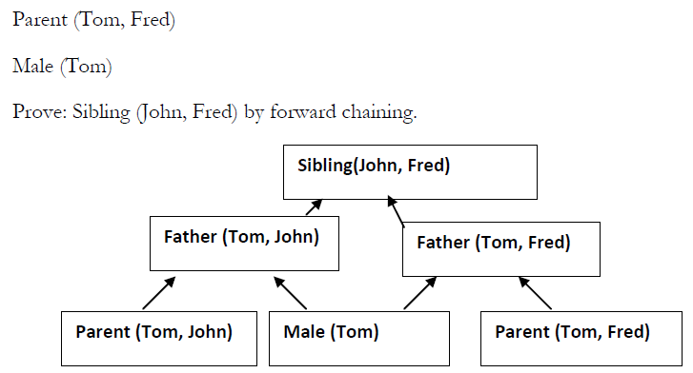
Forward Chaining (Example)
KB
Facts (Predicates
with no Variables)
Prove: Sibling(John, Fred)?

Slide 13
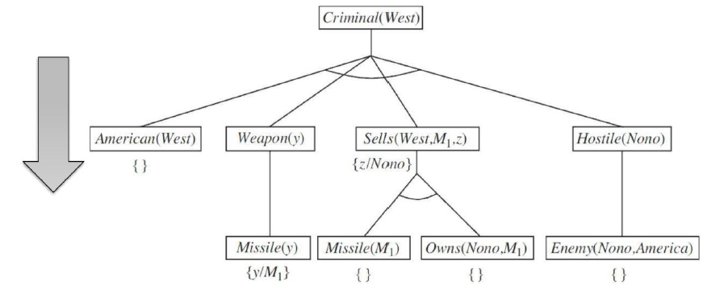
Backward Chaining
Start with goal sentence; search for rules that support goals, adding new sub-goals until
match with KB facts or no further inference can be made.

Slide 14
To be continued …
Thank You

